Slide 1
“...fight for your wives, your daughters...”
(Nehemiah 4:14)

Slide 2
Fear Factor

Slide 3
Psalm 11:5
“The LORD examines both the righteous and the wicked. He hates those who love violence.”

Slide 4
Certain Truths I need to Understand
Self –Defense
Attacker is too close (your aim is to not cross his path)
Must practice regularly (muscle memory)
Truth is, any kind of fight/resistance you will probably survive

Slide 5
THE M.O.M. FACTOR
There are people “out there” who will hurt you
Because of this you have to deal with the “trust factor”
Trust is not freely given; it is earned
John 2:25 – “Jesus trusted no man...”

Slide 6
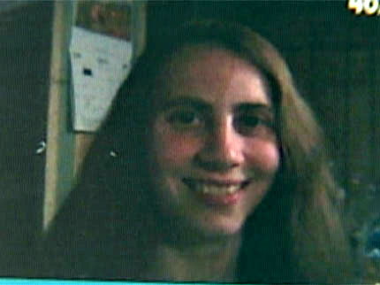
THE M.O.M. FACTOR
Don’t let your religion steal common sense

Slide 7
Violence against women is not going to stop. There are too many contributors

Slide 8
A Federal Agent recently told me....
"I work every federal violation ... terrorism, violent crime, and crimes against children to name just a few...
Perhaps I have become cynical, but I’ve seen child pornography on so many electronic devices associated with men (and women) of all walks of life and faiths, ...
that I am convinced over half of Christian men have viewed child porn at some point...This is a silent cancer eating away at the church, from the inside out..."

Slide 9
THE CRIME TRIANGLE
DESIRE
ABILITY
OPPORTUNITY

Slide 10
THE KEY TO NOT BEING VICTIMIZED...
Removing
the
Opportunity

Slide 11
JESUS UNDERSTOOD THIS....
John 7:1
“After this Jesus went about in Galilee. He would NOT go about in Judea, because the Judeans were seeking to kill Him...”
Proverbs 27:12
“A prudent person foresees danger and takes precautions. The simpleton goes blindly on and suffers the consequences.”

Slide 12
John 10:18
“No one takes it (my life) from me...”

Slide 13
Men have 3 lives
Public
Private
Secret
When you’re dating him, learn all you can
And pay attention to the signs (especially to what he says).
“Out of the abundance of the heart, the mouth speaks...” - Jesus

Slide 14
NO WOMAN ASKS TO BE ASSAULTED....but...
women must learn to NOT put themselves in harm’s way...

Slide 15
So what is the Battle Plan?
Learn to be more ATTENTIVE...
Pay attention to what’s going on INSIDE of you
Pay attention to what’s going on OUTSIDE of you

Slide 16
Battle Plan
There are more distractions than ever...
Attentive to your environment
Parking Lots
Walking along

Slide 17
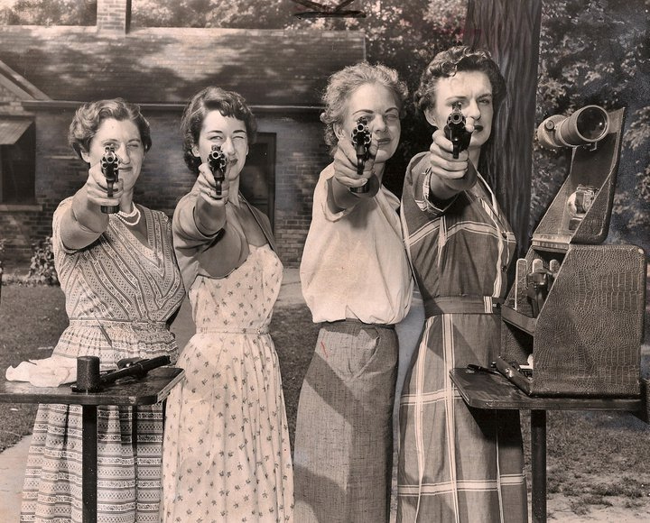

Slide 18
Pepper Spray

Slide 19
Lies that abused women believe
If I leave it will hurt the kids
I can change him
Leaving him would be a sin (divorce)
It’s my fault
And one of the biggest lies I have witnessed is women who suffer from a sense of...
Worthlessness

Slide 20
Signs that Violence may be near...
Is he controlling?
Does he constantly talk about his authority as husband
Is he jealous of your relationships
Does he have to know where you are all the time
Do you fear him
Does he call you names (the 4 names)
What about his temper...

Slide 21
Road Rage
Get off the road...to a lighted area
Do NOT engage the other driver

Slide 22
At home alone...
There is no need to open the door
Talk through the door

